Slide 1








Learning a meaningful latent space representation
for patient risk stratification: model development
and validation for dengue
On behalf of the Vietnam ICU Translational Applications Laboratory (VITAL) investigators (vital.oucru.org)
Bernard Hernandez
b.hernandez-perez@imperial.ac.uk
Center for Bio-Inspired Technology
Imperial College London
23rd of April 2022
1
Bernard Hernandez, Oliver Stiff, Damien Ming, Nguyen Vuong, Ho Chanh, Nguyen Nguyet, Nguyen Huy Quang, Cameron Simmons, Bridget Wills, Alison H Holmes, Sophie Yacoub, and Pantelis Georgiou.
On behalf of the Vietnam ICU Translational Applications Laboratory (VITAL) investigators (vital.oucru.org)

Slide 2

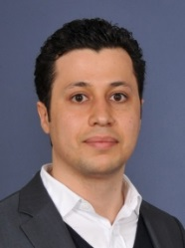





INTRODUCTION
“The aim of the work package is the development and roll-out of a clinical decision support system (CDSS) for the early identification of severe dengue in hospital settings, namely dengue shock and other relevant clinical outcomes. The CDSS module will be based on previous work done by the group for supporting antimicrobial prescribing in acute care and will utilise machine-learning based algorithms in order to support different aspects of decision-making in dengue management.“
+ more!

Slide 3
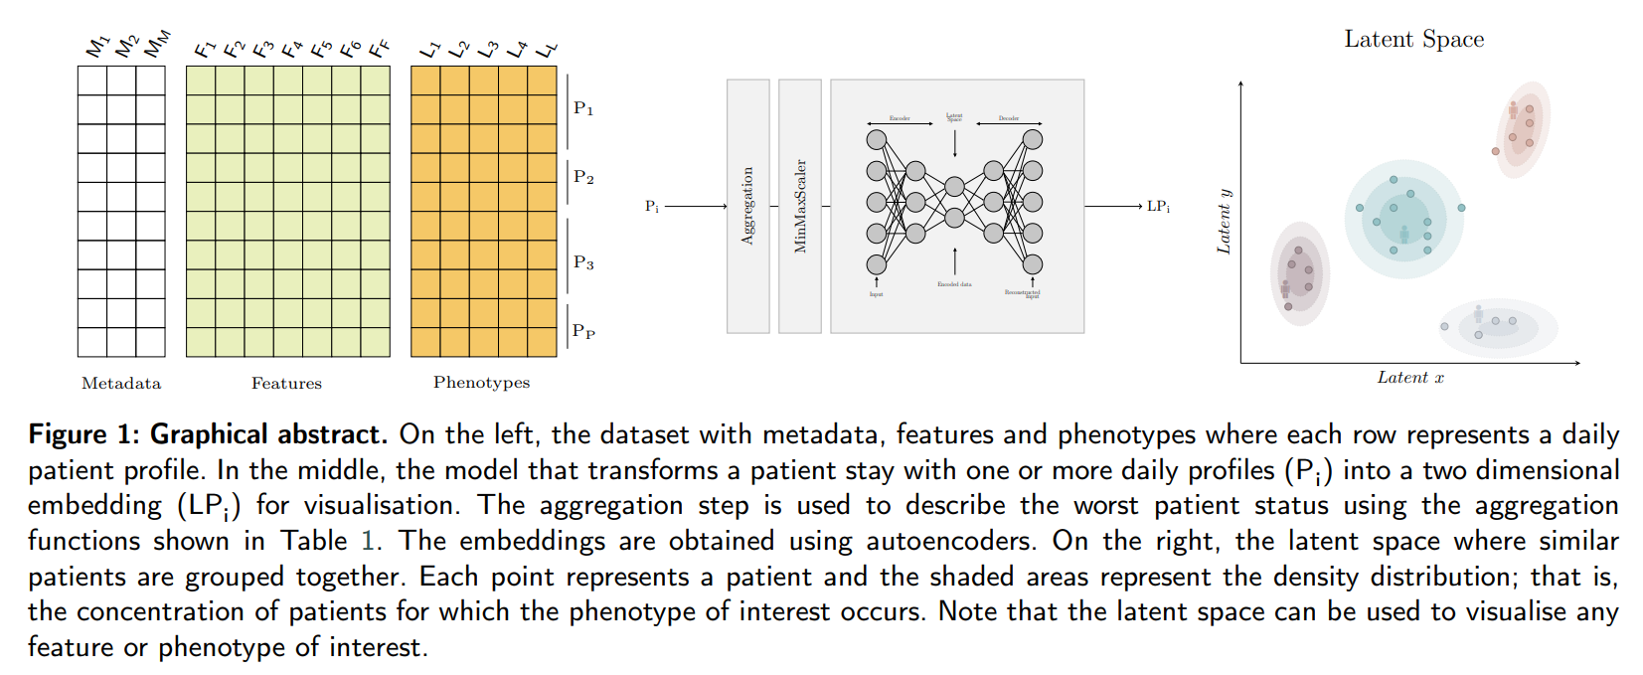

GRAPHICAL ABSTRACT
AIM: Development of a clinical decision support tool to support clinical management of patients with (or under suspicion of) dengue using unsupervised techniques to reduce data complexity and facilitate visualisation.
Dataset
Model
Embeddings

Slide 4
THE DATASET
The dataset used in the study consists of an aggregation of prospective clinical data conducted at the Hospital of Tropical Diseases (HTD) and collaborator hospitals in Ho Chi Minh City, Vietnam by Oxford University Clinical Research Unit (OUCRU) between 2000 and 2021.
12,884
patients¹
19,516
complete daily profiles
Code | Year | Population | Type of care | # patients
06DX | 2009-2011 | A&C | Inpatient | 318
13DX | 2010-2014 | Children | Outpatient | 8107
32DX | 2013-2016 | A&C | Inpatient and ICU | 75
42DX | 2016-2018 | A&C | Inpatient and ICU | 664
DF | 1999-2009 | Children | Inpatient and PICU | 1719
DR | 2005-2008 | Children | Outpatient | 1165
FL | 2006-2009 | A&C | Inpatient | 740
MD | 2001-2009 | Children | Inpatient | 3044
01NVA | 2020-2021 | Children | Inpatient | 150*
4,344 (33.7%)
diagnosed with dengue²
10
datasets
¹ Only children (under 18 years old) have been considered since they were the most commonly represented in the datasets and there are separate paediatric and adult dengue guidelines.
² Dengue diagnosis was defined as one of i) a positive NS1 point of care assay or NS1 ELISA, ii) positive reverse transcriptase-polymerase chain reaction (RT-PCR), iii) positive dengue IgM through acute serology, iv) or seroconversion of paired IgM samples where available.
20
years
Vital-oucru-clinical documentation (https://bahp.github.io/vital-oucru-clinical/)

Slide 5






SELECTING THE APPROACH
Supervised vs Unsupervised: important considerations
Needs the ground truth or label for which the model is optimised.
It returns a probability which might be difficult to interpretate.
Needs to be (re)trained for each label or phenotype.
Outputs from different algorithms (e.g. shock and fluid accumulation) must be consistent.
Lacks explainability; that is, what are the underlying reasons motivating such probabilities.
Relatively easy evaluation through standard metrics such as ROC, SENS or SPEC.
Notes:
About supervised machine learning models:
- Needs a ground truth or label.
- Probabilities are concise but might lack explainability; for instance, how to relate these probabilities with pathology changes.
- Needs one model for each phenotype.
- We can create one model for each phenotype but… how do they work together, are they consistent?
- Clinicians make decisions based on knowledge.
- Easy to evaluate their performance

Slide 6
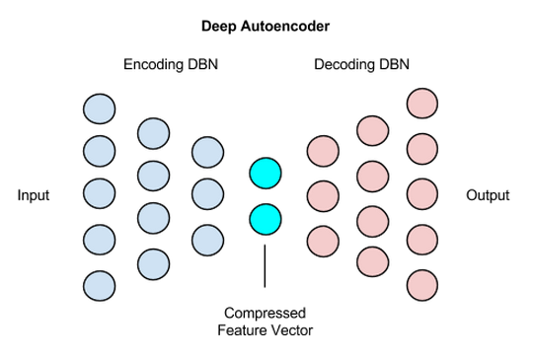
SELECTING THE MODEL
The input features selected are:
- Age (years)
- Weight (Kg)
- Body Temperature (°C)
- Platelets (k/µ L)
- Haematocrit (%)
- Features were consistently recorded in all clinical studies.
- Provide information on the course of dengue illness (WHO).
- Feasibility of prospective collection
Algorithm | Type | Metrics | Comments
PCA | Parametric | Good distance metrics. Density metrics are decent but inferior to SOM/AE. | Performance of PCA is likely to decrease as dimensionality increases due to its linear nature.
t-SNE | Non-parametric | Performance highly dependent on hyperparameters | High computationally expensive to create embeddings for unseen data. Can create completely separated clusters.
SOM | Non-parametric | Poor distance preservation. Good density metrics. | Limitations imposed by the discrete space limit its usability for similarity retrieval.
AE | Parametric | Good performance for both distance and density metrics. | Quite a flexible approach, possible to use with time-series signals or even images.
¹ UMAP might be also a promising algorithm.
Notes:
Only 5 features were selected:
- They were consistently collected in all clinical studies.
- Adding more features with hinder its implementation/use in LMIC.
PCA = parametric
TSNE = non-parametric
UMAP = non-parametric
SOM = parametric
Autoencoder = parametric
While t-SNE does retain some of the global structure, making it a helpful tool for further analysing the dataset, it has some limitations when applied to the present use case: identifying and visualising patients similar to a given, previously unseen, patient. Indeed, the algorithm learns a non-parametric mapping, meaning that it does not produce an explicit function which maps the input space to the output, lower-dimensional space. Project a new data-point it is possible but very inefficient compared to parametric approaches.
The poor preservation of distances can largely be explained by the limited number of nodes points are projected onto. While, for the most part, closer points are more similar to one another, the limited number of locations that points can be mapped to restricts the extent to which SOMs can be used for similarity retrieval.

Slide 7
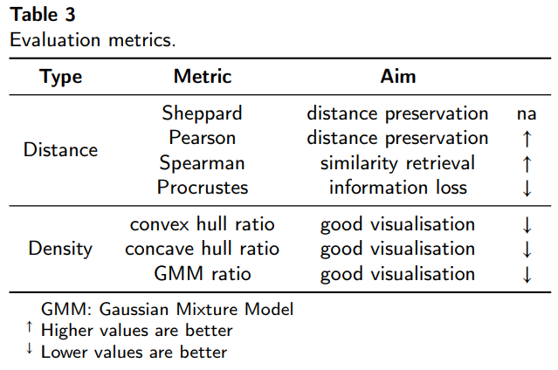
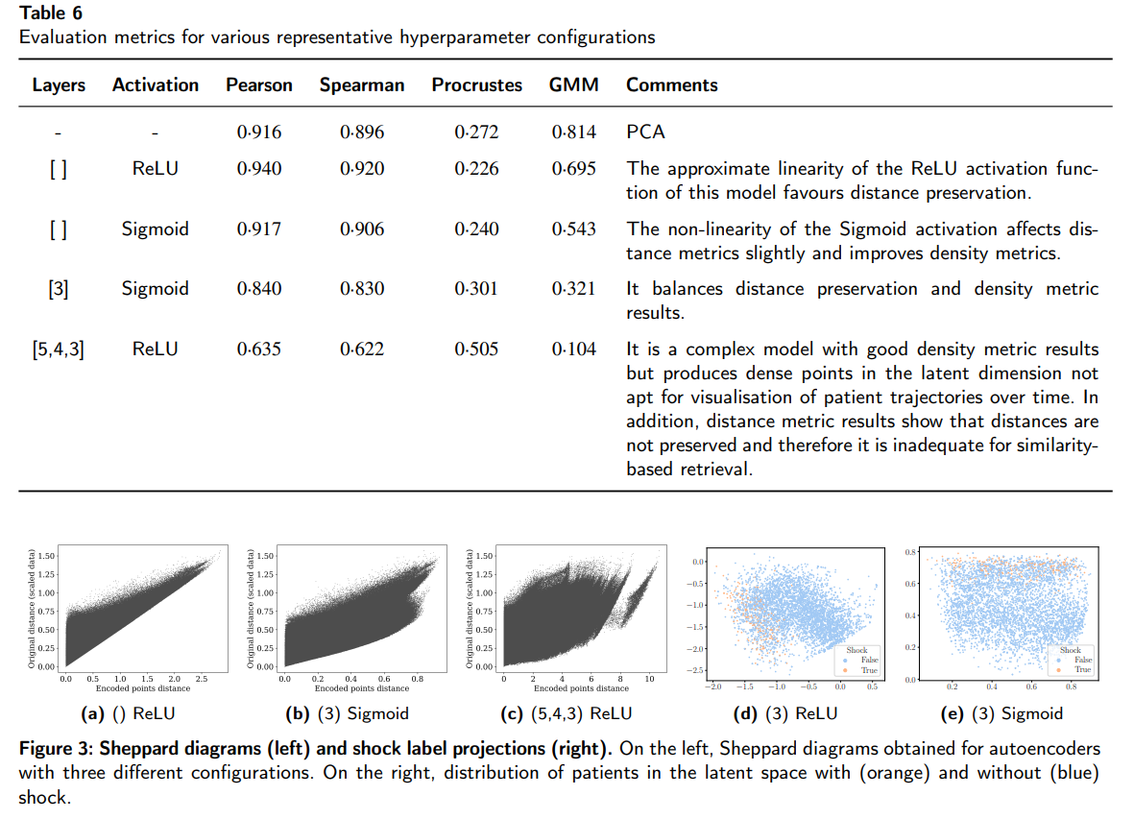
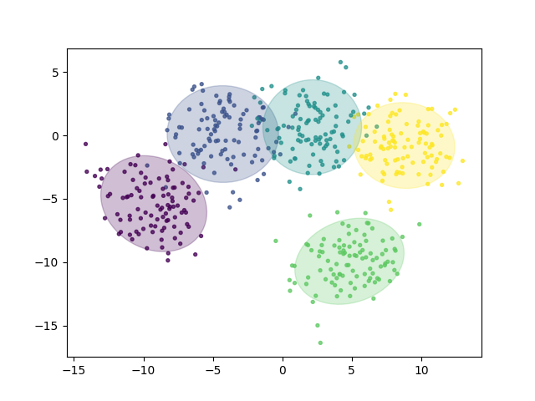
PERFORMANCE METRICS / RESULTS
GMM ratio
Notes:
Sheppard diagrams are scatter plots of two measurements of distances between objects. In dimensionality reduction analysis, the first measurement or collection of distances corresponds to the points in the original dimension. The second measurement is the distances in the reduced space. The diagram shows how well distances have been preserved relative to one another. Collinear points indicate that there has been no distortion. The more points do not lie on this line, the more the distances have been distorted and information lost whilst reducing the dimensionality.
The Pearson correlation coefficient is a statistical measure that gives the linear correlation between two variables.
Spearman rank correlation coefficient: It measures the dependence between the rankings of two variables. There are applications where maintaining the ordering of distances is more important than having a linear relationship between the distances in the original and reduced spaces. Similarity retrieval, for example, will provide the same results in the original space and the two-dimensional space if the Spearman rank correlation coefficient of the distances in both spaces is one.
The GMM ratio uses Gaussian Mixture Models with one component. The metric takes the ratio of the area of the confidence ellipsoid of a model fitted to data points with a given label to the area of the confidence ellipsoid of a model fitted to all data points.

Slide 8
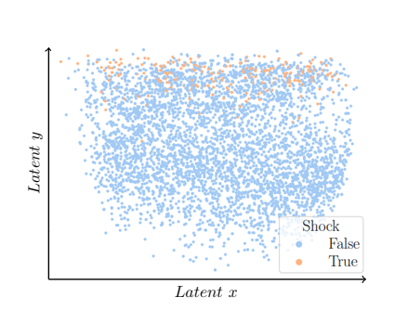
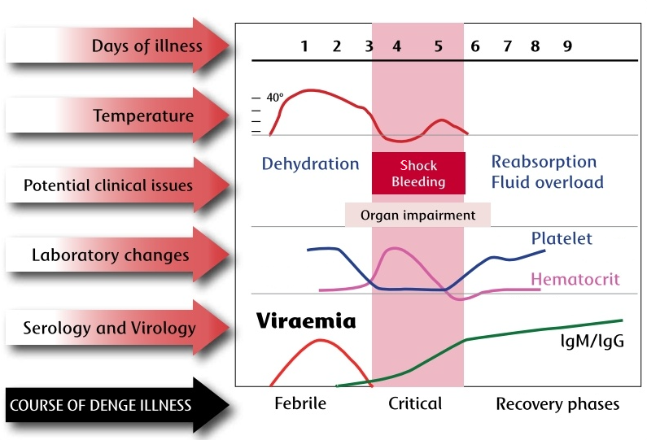
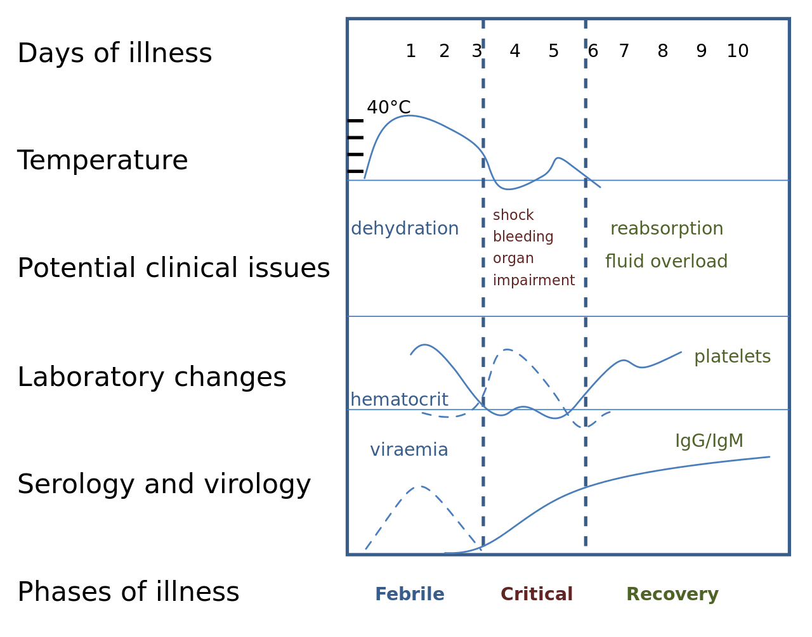
EVALUATION (I) - EMBEDDINGS
Allows easy and complete visualisation of all the patients over the latent space.
Figure 1. The course of dengue illness diagram. The figure, which has been adapted from WCL Yip, et all 1980 [28], presents phases, lab results, and associated problems.
Figure 2. Latent space: embeddings. The worst patient status for all the patients has been projected into the latent space with the shock phenotype.

Slide 9
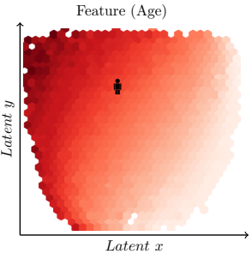
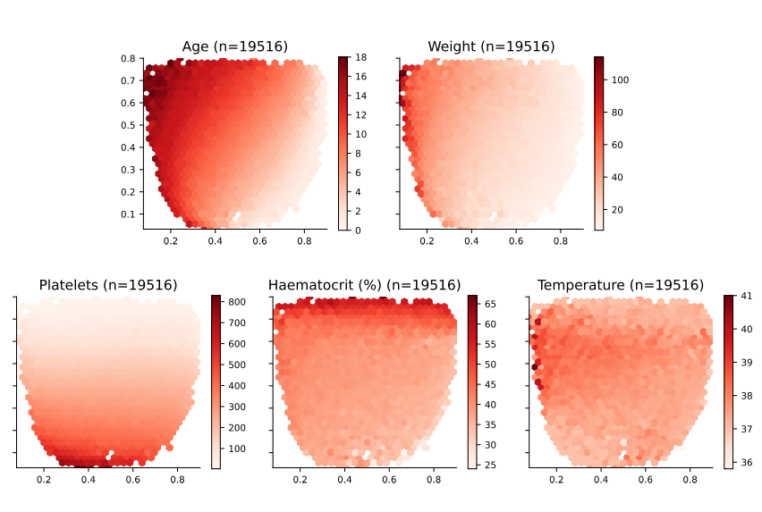
EVALUATION (II) - FEATURES
Aligns with established characteristics of disease progression such as increase in haematocrit levels, decrease in platelet levels and decrease in body temperature from febrile to critical phase.
Figure 1. The course of dengue illness diagram. The figure, which has been adapted from WCL Yip, et all 1980 [28], presents phases, lab results, and associated problems.
Figure 3. Latent space description: Features. The graphs represent the density distribution using hexagonal binning over the latent space.

Slide 10
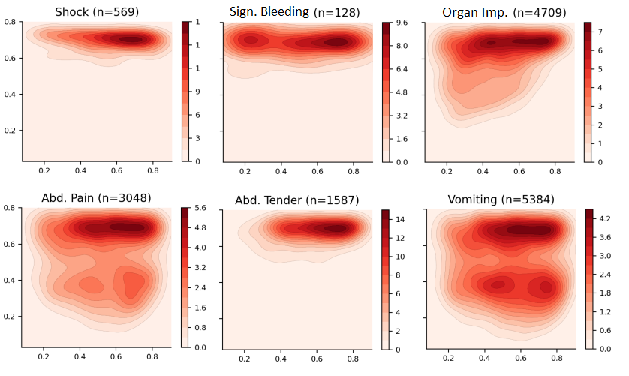
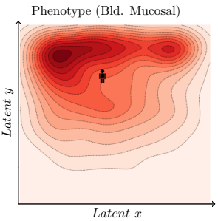
EVALUATION (III) - PHENOTYPES
Similar phenotypes are presented close to each other.
Figure 1. The course of dengue illness diagram. The figure, which has been adapted from WCL Yip, et all 1980 [28], presents phases, lab results, and associated problems.
Figure 4. Latent space description: Phenotypes. The graphs represent the density distribution using contour lines using a Gaussian kernel.

Slide 11
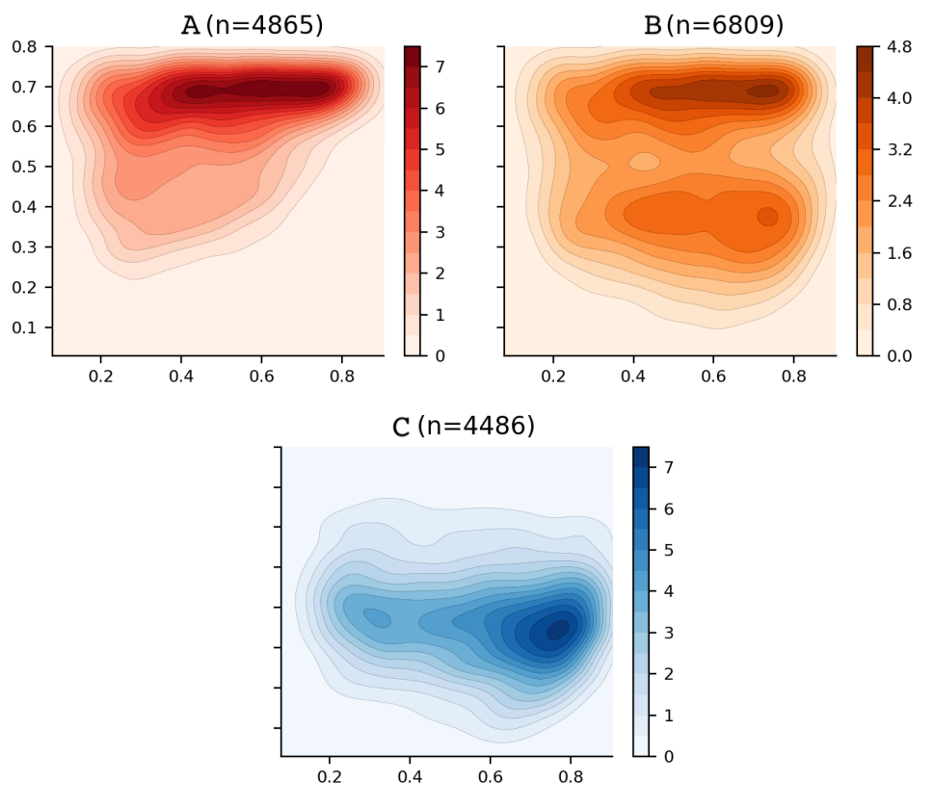
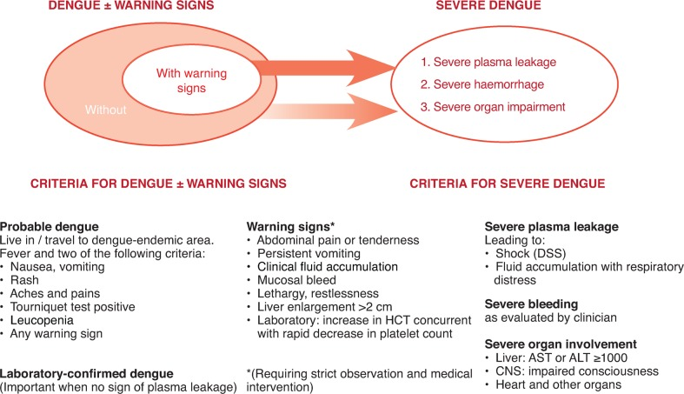
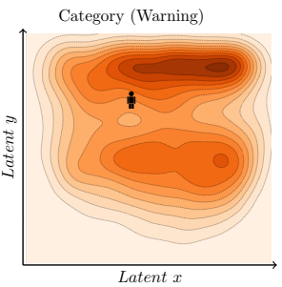
EVALUATION (IV) - CATEGORIES
The approach allows to create categories as a compendium of phenotypes and facilitates its visualisation. In addition, for the current scenario, the defined categories A, B, and C are consistent with the WHO 2009 guidelines.
Figure 5. The 2009 revised dengue case classification. Diagram with the 2009 dengue classification system proposed by WHO for the diagnosis and management of dengue [6].
Figure 6. Latent space description: Categories. The graphs represent the density distribution over the latent space for three categories defined as a compendium of various phenotypes.

Slide 12
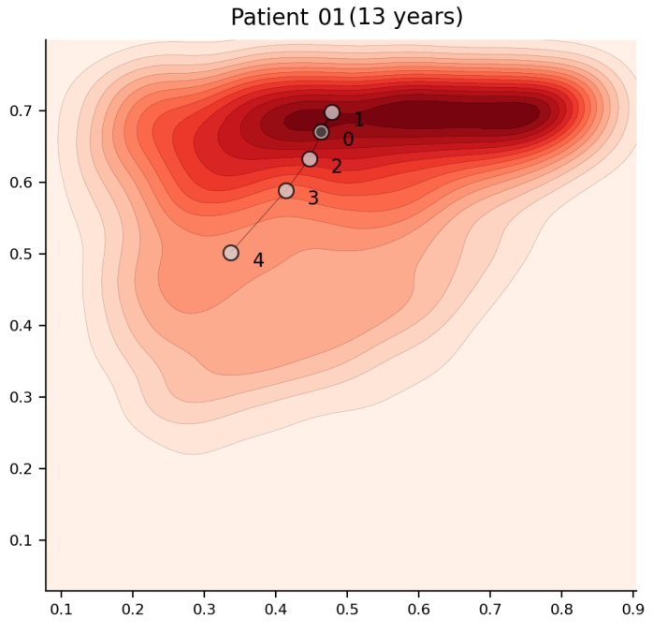
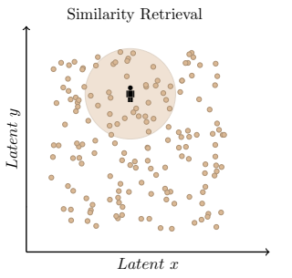
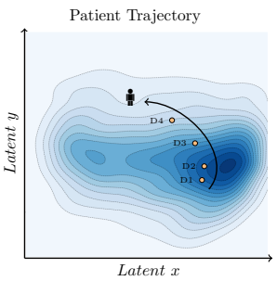
EVALUATION (V) – TRAJECTORIES AND RETRIEVAL
Allows to visualise patient trajectories over time.
Allows to retrieve similar patients more efficiently (and easier to understand).
Figure 7. Latent space description: Trajectories. The graphs represent the trajectory of a patient over Category A. The number represents the day from admission.
Figure 8. Latent space description: Similarity retrieval. The diagram represents a query patient and the area of interest for which patients, which are deemed to be similar, should be retrieved.

Slide 13
EVALUATION (VI) – DEMOGRAPHICS TABLE
Work carried out by Oliver Stiff (MEng), clusters identified through GMMs.
* indicates attributes used in training.

Slide 14
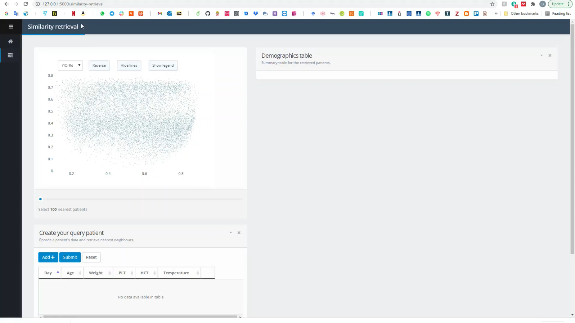
THE SUPPORT TOOL

Slide 15
QUESTIONS
?
Bernard Hernandez
b.hernandez-perez@imperial.ac.uk
Center for Bio-Inspired Technology
Imperial College London
23rd of April 2022

Slide 16
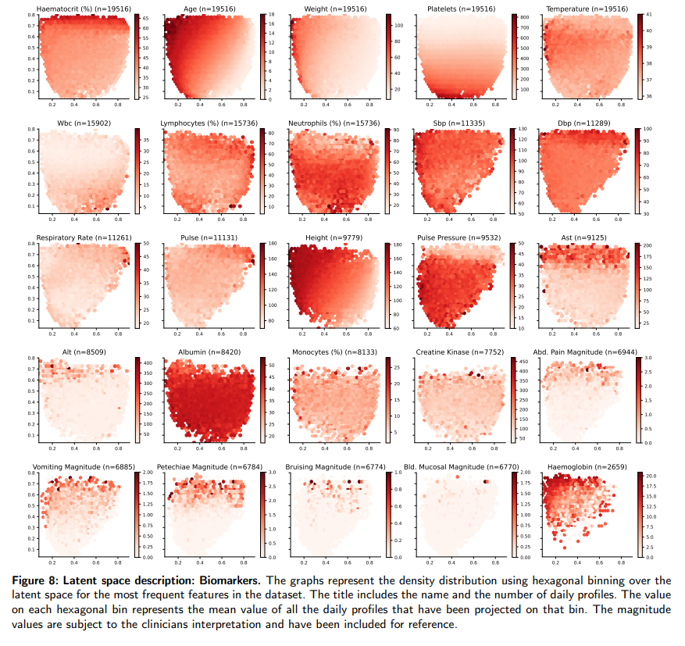
APPENDIX - FEATURES
*

Slide 17
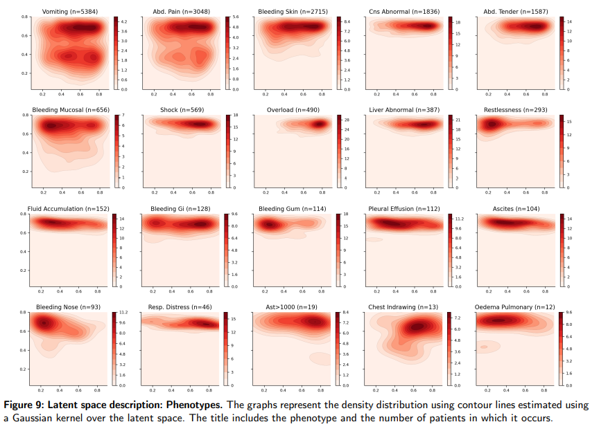
APPENDIX - PHENOTYPES
*

Slide 18
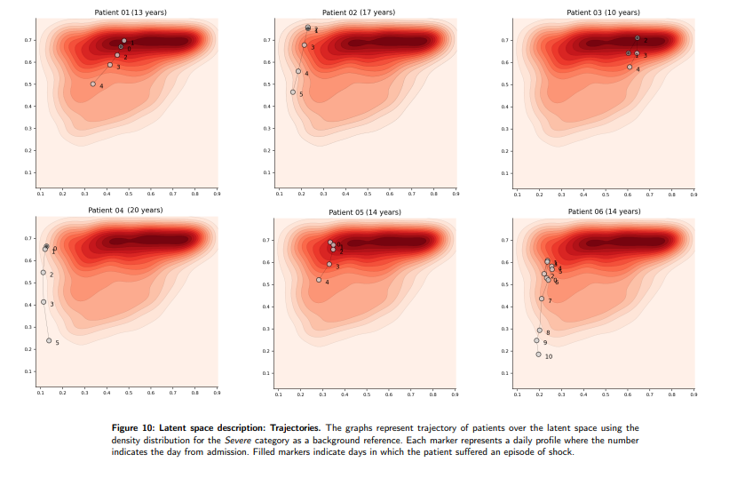
APPENDIX - TRAJECTORIES
*

Slide 19
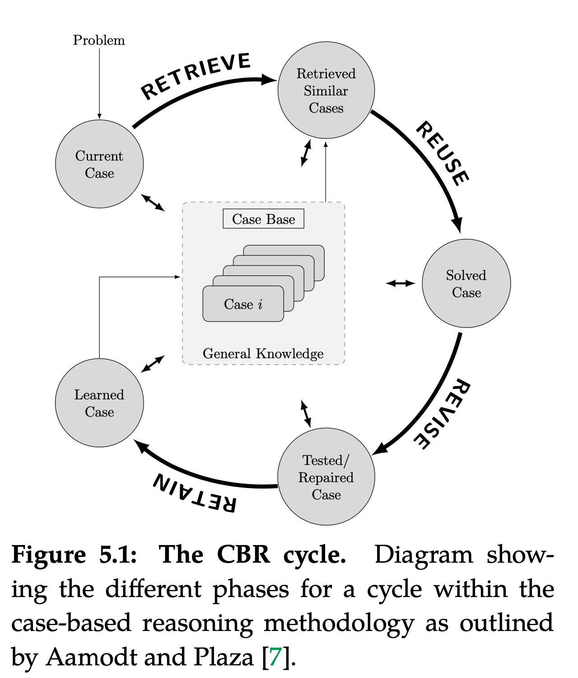
CBR MODULE
The E. Coli case study 145 patients (all received antibiotics) Antimicrobial Spectrum index (ASI) Physicians - 83% appropriate CBR - 90% appropriate
*
B Hernandez et al Data-driven web-based intelligent CDSS for infection management… – Health Informatics (2017)
TM Rawson et al A real-world evaluation of CBR to support antimicrobial prescribing… - CID (2020) *
Notes:
The aim of Case-Based Reasoning (CBR) is to solve new problems based on the solutions of similar past problems. And in fact, CBR aligns very well with the methodology used in clinical environments where physicians make decisions based on knowledge acquired from past cases personally experienced. As an example, lets assume that the physician has a patient in front of them (current case), then….. [keep explaining the graph]
We evaluated the system in a cohort of 145 individual patients (with all of them receiving antibiotics). In order to compare the prescriptions, we used the Antimicrobial Spectrum Index (ASI) which aims to classify agents based on activity against important pathogens. Summarising the results, 90% of the CBR recommendations were deemed appropriate based on the ASI in comparison with 83% of appropriate prescriptions made by physicians. There was no statistically significant difference between the recommendations. Note that ASI provides a metric that describes the spectrum of antimicrobial rather than simply deeming it as appropriate / inappropriate. More information can be found on the paper marked with an asterisk below.

